Slide 1

SOCIAL TRENDS IN COMPUTER GAMING 2

Slide 2
Multiplayer
Local multi-player has been popular for some time. | However, online multi-player has become huge.
Growth of Multiplayer
Multiplayer Trends
Mobile gaming has been an important growth area of online gaming due to mass reach.
56% of regular gamers play online games.
Most popular multiplayer genres are shooter, action & casual.
DLC & microtransactions with online games provide ongoing revenue for developers.
https://www.statista.com/statistics/656278/steam-most-played-games-peak-concurrent-player/

Slide 3

Artificial Intelligence
Provides intelligent behaviours from non-player characters in games.
Search Algorithms
Advanced algorithms for searching, such as A* path-finding.
Logic
Game decision making through behaviour trees & utility ai.
Common also in puzzle games for finding solutions.
Allows for more realistic decision making.

Slide 4
Emerging Technologies
There have been major new technologies in gaming. | VR, AR & Mobile gaming have made big impacts.
Virtual & Augmented Reality
Changing Platforms
Virtual reality headsets are common place and allow gaming within a virtual world.
Mobile gaming has changed the way many play games.
Augmented reality seen in some basic levels to bring gaming into our world.
Switch brings together handheld & console gaming.
Seeing other devices like smartwatches.
https://www.statista.com/statistics/591181/global-augmented-virtual-reality-market-size/

Slide 5
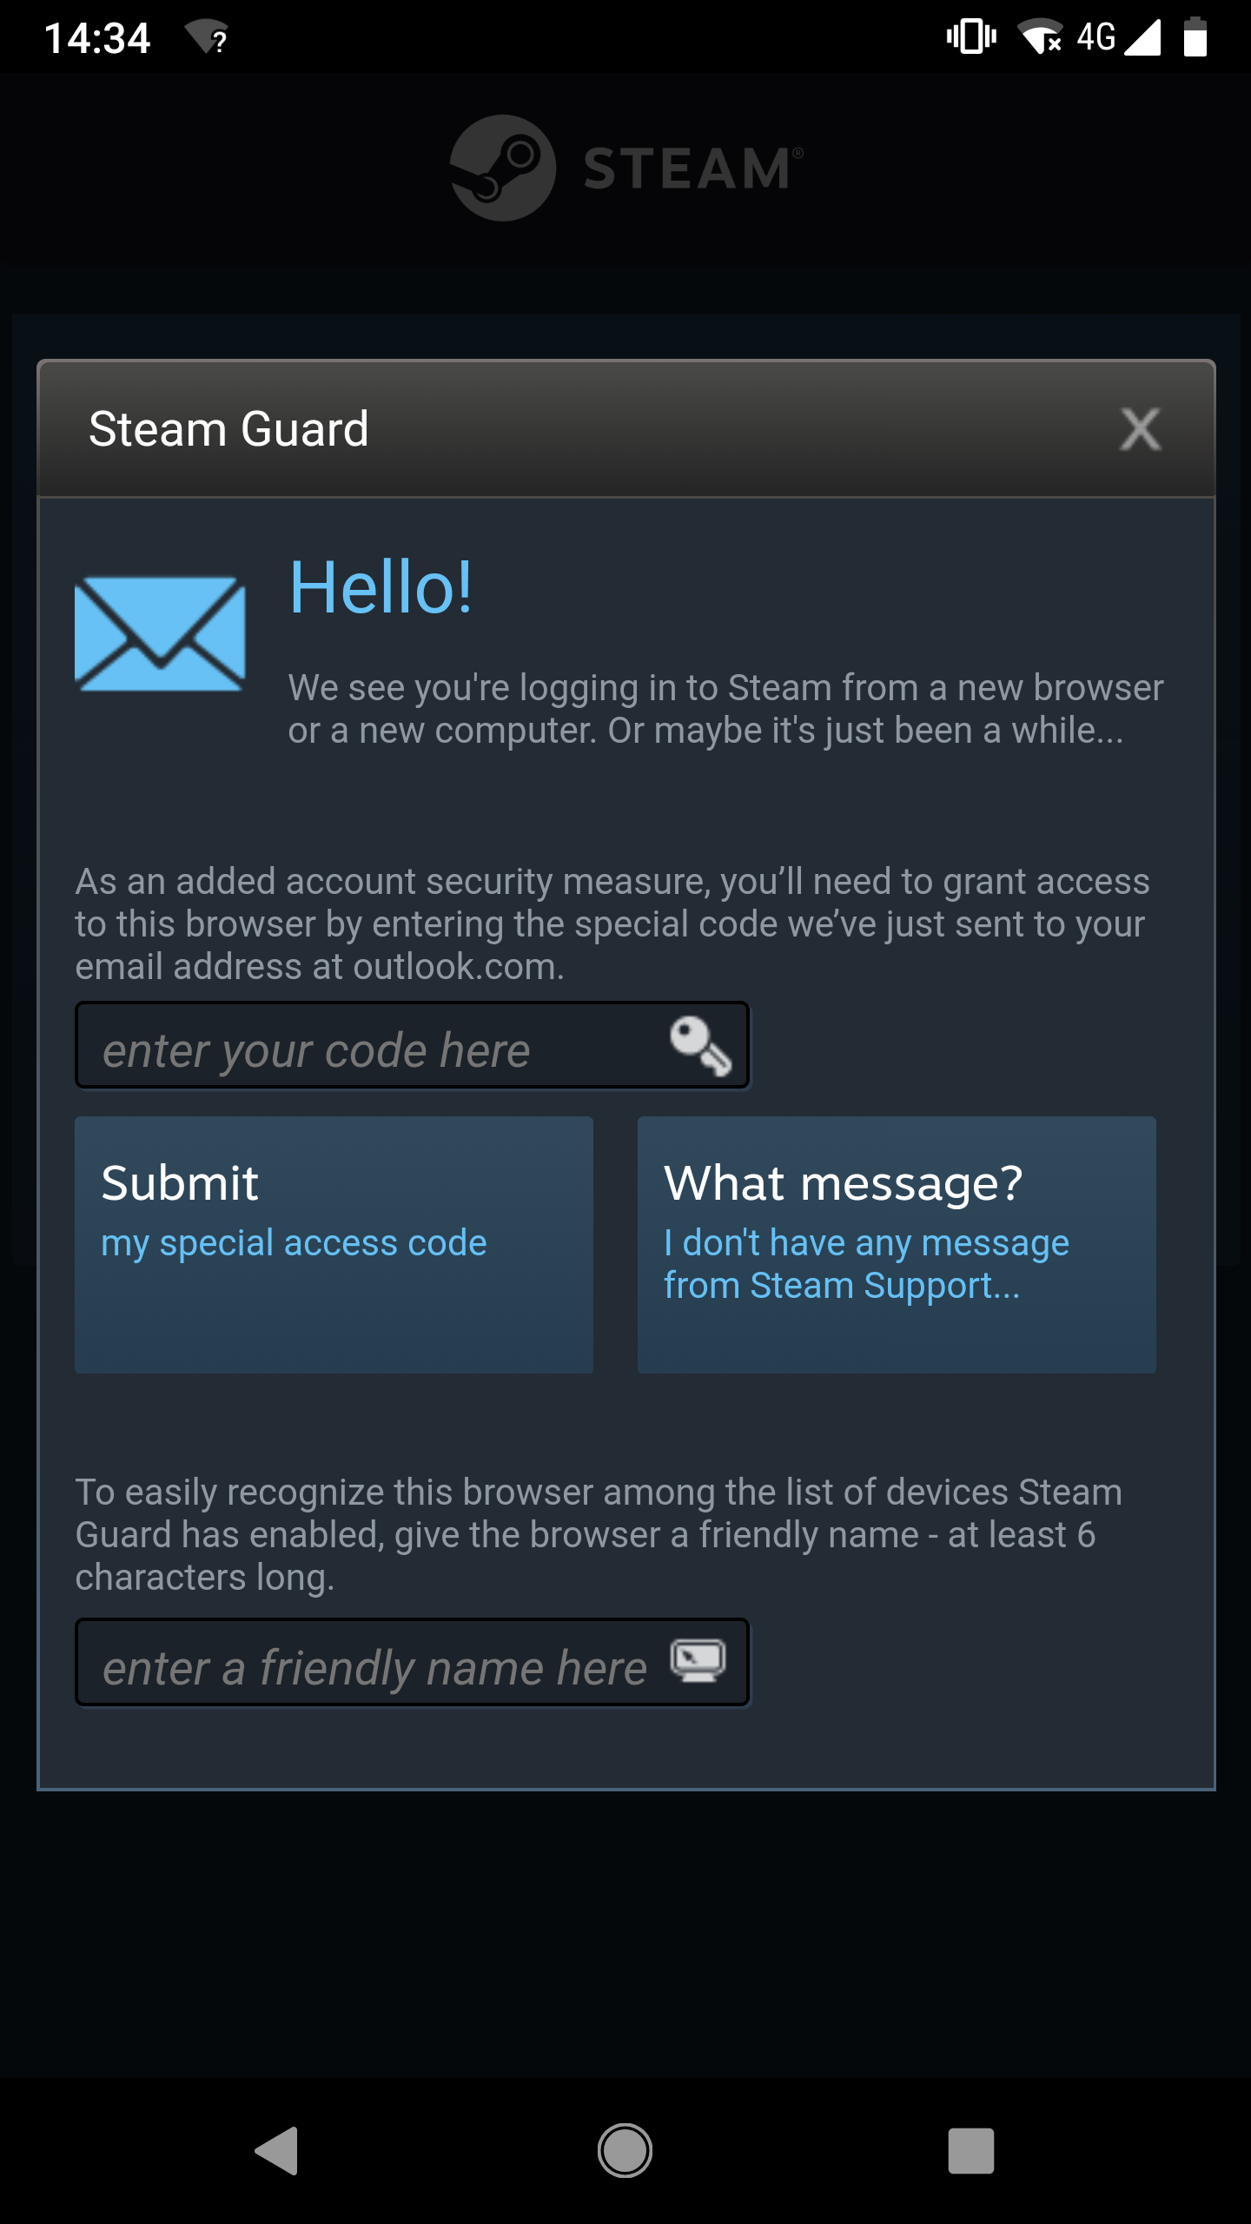
Security
We see more people using services like Steam & multiplayer environments that are subject to threats.
MMO & Integrated Service Accounts can be Hacked
Development of Protection Measures
We often store personal information & financial information.
Increased complexity in passwords have helped.
We also have digital products that have real money value.
Many of these games/services have been hacked & had things stolen.
We’ve seen the addition of two-factor authentication.
Preventing account activity from new locations.

